Slide 1
Introduction and Methodology

Slide 2






The 2024 Nigeria Demographic and Health Survey (2024 NDHS) was implemented under the aegis of the Federal Ministry of Health and Social Welfare by the National Population Commission (NPC). The funding for the 2024 NDHS was provided by the Government of Nigeria, the United States Agency for International Development (USAID), the United Nations Population Fund (UNFPA), the United Nations Children’s Fund (UNICEF), and the Global Fund to Fight AIDS, Tuberculosis and Malaria (Global Fund). ICF provided technical assistance through The DHS Program, a USAID-funded project providing support and technical assistance in the implementation of population and health surveys in countries worldwide. The World Health Organization also provided technical assistance.
The contents of the report and presentation are the sole responsibility of the NPC and ICF and do not necessarily reflect the views of USAID, the United States Government, or other donor agencies.

Slide 3
Objective
The main objective of the 2024 NDHS is to provide current estimates on fertility levels, family planning, maternal and child health, nutrition, childhood mortality, women’s empowerment, domestic violence, female genital mutilation (FGM), fistula, disability, knowledge, awareness, and behaviour regarding, malaria, tuberculosis, and HIV/AIDS and other sexually transmitted infections (STIs), and other health-related issues.
This information is essential for program managers and policymakers to evaluate and design programs and strategies for improving the health of the country.

Slide 4
The Survey
The 2024 NDHS is the 6th Demographic and Health Survey conducted in Nigeria since 1990 as part of The DHS Program.
It is designed to provide estimates at the national level, for urban and rural areas, six zones, and the 36 states and the Federal Capital Territory.

Slide 5
Sample Design
Sampling Frame: cartographical frame from the Population and Housing Census
First Stage: 701 urban and 699 rural clusters selected
Second Stage: 30 households per cluster were selected.
Selected households were visited and interviewed. All women age 15-49 in all selected households and men age 15-59 in one-third of the selected households were interviewed. Anthropometry and biomarkers were collected in households selected for man’s survey.

Slide 6
Nigeria
Sokoto
Katsina
Zamfara
Jigawa
Yobe
Borno
Kano
Kebbi
Kaduna
Bauchi
Gombe
Adamawa
Niger
Plateau
Kwara
FCT
Nasarawa
Oyo
Taraba
Osun
Ekiti
Kogi
Benue
Ogun
Ondo
Edo
Lagos
Ebonyi
Anambra
Delta
Imo
Cross River
Enugu
Bayelsa
Abia
Rivers
Akwa
Ibom

Slide 7
Questionnaires
Household Questionnaire
Woman’s Questionnaire
Man’s Questionnaire
Biomarker Questionnaire
Questionnaires were translated from English to Hausa, Yoruba, and Igbo.

Slide 8
Household Questionnaire
Lists usual members and visitors to identify eligible individuals
Basic characteristics of each person in the household (age, sex, education, etc.)
Housing characteristics (drinking water, sanitation facilities, etc.)
Ownership of durable goods
Food security

Slide 9
Woman’s Questionnaire
Background characteristics (age, education, literacy, etc.)
Pregnancy history and child mortality
Family planning
Antenatal, delivery, and postnatal care
Vaccinations and childhood illnesses
Breastfeeding and infant feeding practices
Women’s minimum dietary diversity
Marriage and sexual activity
Fertility
Women’s work and husbands’ background characteristics
HIV/AIDs and other STIs
Other adult health issues
Domestic violence
Female genital mutilation (FGM) and fistula

Slide 10
Man’s Questionnaire
Background characteristics (age, education, literacy, etc.)
Marriage and sexual activity
Fertility
Employment
HIV/AIDs and other STIs
Other adult health issues
Adult and maternal mortality
Identify individuals for anthropometry

Slide 11
Biomarkers
Height and weight measurements:
Children under age 5
Women age 15-49
Haemoglobin testing:
Children age 6–59 months
Women age 15-49

Slide 12
Pretest and Main Survey Training
Pretest:
Training from 16 September-7 October 2023 with 40 trainees
Main Survey Training:
Training from 1 November-1 December 2023 with 355 fieldworkers

Slide 13
Fieldwork and Data Processing
Total of 37 teams
1 supervisor, 1 CAPI supervisor, 3 female interviewers, 2 male interviewers, 2 biomarker technicians, and 1 driver
Fieldwork conducted from 1 December 2023 to 7 May 2024
Electronic data collected on tablets through the CAPI system were received by NPC
Data processing personnel conducted data editing with CSPro.

Slide 14
Results of Household and Individual Interviews
Household Interviews
Households selected | 41,115
Households occupied | 40,314
Households interviewed | 40,047
Response rate | 99%
Interviews with Women age 15-49
Eligible women | 39,553
Women interviewed | 39,050
Response rate | 99%
Interviews with Men age 15-59
Eligible men | 12,426
Men interviewed | 12,204
Response rate | 98%

Slide 15

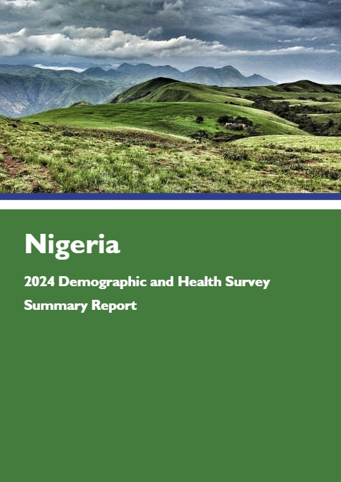
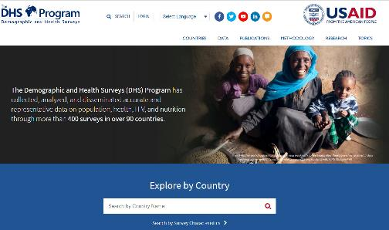
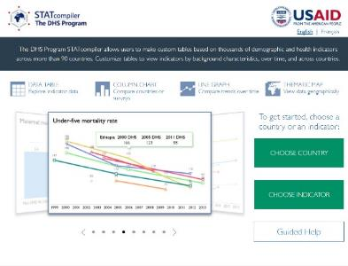

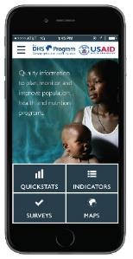
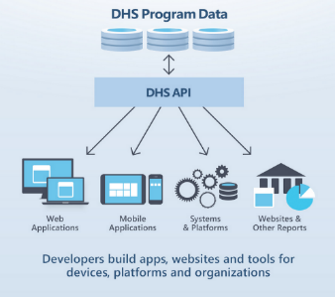
NDHS Publications, Data, and Digital Tools
Dataset available at DHSprogram.com
Final Report
Summary Report
DHS Program Mobile App for Android & iOS
STATcompiler.com
API.DHSprogram.com
Notes:
Please note that all materials, digital tools and datasets with CDHS data will be made publicly available online within 1 day following the National Seminar. Print materials are available from [implementing agency].
[Add in implementing agency’s web address if they plan on uploading survey materials to their website.]

Slide 16





DHS Program Digital Tools
Access the Code Share Library on GitHub
Watch tutorial videos on YouTube
DHS Program User Forum
Blog.dhsprogram.com
spatialdata.dhsprogram.com
DHS Program Learning Hub

